Slide 1
Collaboration Empowered by Health and Social Care Devolution
Ben Bridgewater
Health Innovation Manchester Chief Executive

Slide 2
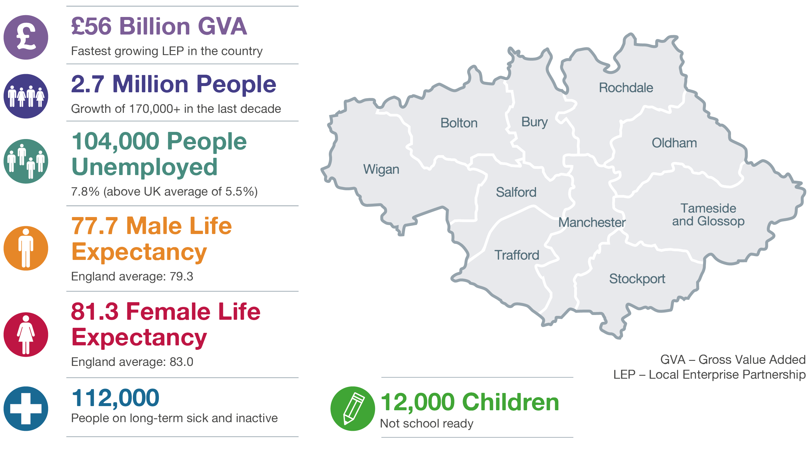
About Greater Manchester
Patient outcomes across Greater Manchester are currently below national averages against a range of disease and mortality figures and faces significant public health challenges
Strategic document sets clear framework for needs led innovation

Slide 3






Greater Manchester devolution
Health and social care devolution is a catalyst for change
Why?
What?
Significant variation in population health outcomes, from national standards and across localities.
Delegated financial control of £6bn health and social care budget.
Economic productivity inhibited by poor health of population.
Established governance structures and integrated commissioning at city-region and locality level.
Strong delivery track record of collaboration and delivery across the city region.
Integrated academic health science and innovation system, Health Innovation Manchester.
Notes:
Timeline of key Devolution events
March 2015 - A Programme Board to oversee the transition to full health and social care devolution met for the first time.
April 2015 - Arrangements began to form two shadow bodies:
A Health and Social Care Strategic Partnership Body to oversee strategic development
A Joint Commissioning Body to agree decisions on Greater Manchester-wide spending.
July 2015 - Public Health MoU - Launch of a new model of public health leadership in GM, putting public health at the heart of wider economic and skills potential by helping people into work, encouraging independence and reducing demand on the NHS.
July 2015 – Spending Review - Commitment in July 2015 budget to align the Spending Review process for health and social care to GM §Strategic Sustainability Plan.
September 2015 – Health Innovation Manchester Conception – Bringing together world class experts in health, academia and industry to enable GM to compete on a global level through aligning Manchester Academic Health Science Centre (MAHSC), Greater Manchester Academic Health Science Network (GMAHSN) and Local Clinical Research Network (LCRN)
October 2015 - Shadow arrangements in place and start for governance and accountability,
December 2015 - Workforce Pilot - A secure agreement across provider organisations in GM on common standards on pre-employment checks, statutory and mandatory training and common rates for specific targeted locum and agency staff.
December 2015 - In preparation for devolution, Greater Manchester and NHS England approved the details of the devolution of funds and governance arrangements. Local authorities and CCGs formally agreed the integrated health and social care arrangements. Also produced and agreed a Greater Manchester Health and Social Care Strategic Sustainability Plan.
April 2016 - Full devolution and/or delegation with final governance arrangements in place.
October 2017- GMAHSN and MAHSC brought together to create Health Innovation Manchester

Slide 4






The devolution difference
Devolution has
Effective financial control
Effective smoking cessation, improved school readiness
10% primary care extended access
Increased good and outstanding care homes
Improvements in emergency care and delayed discharge metrics

Slide 5

Challenges to introducing innovation at pace are global issues
The rising costs and slow introduction of innovative solutions are a major frustration to policy-makers and care providers and industry
The obstacles preventing rapid implementation
^{of innovations nationwide:}
Increase in over 65s population between 2011 and 2021
Fragmented and slow decision-making
Structures which do not assist collaboration and co-ordination
Lengthy and uncertain routes to adoption
Increase in over 85s population between 2011 and 2021
Funding deficit to the health economy by 2021 if no action is taken
Excellent initiatives in one locality are not shared across the system
Industry find multiplicity of organisations/initiatives confusing and add to risk
Notes:
Like all cities and countries, Greater Manchester is facing significant public health challenges. This is against a backdrop of rising health and social care costs.
At the same time, the challenges and barriers to introducing innovation into health and social care services at pace are global issues.
Empowered by devolution, Greater Manchester is uniquely placed to tackle both of these challenges.
With a single accountable body responsible for the city region’s annual £6 billion health and social care budget, for the first time, Greater Manchester can adopt a system-wide view of the most pressing health and social care needs, agreeing shared priorities, and streamlining processes to enable faster decision-making.
An accompanying system-wide approach to innovation is also critical. Health Innovation Manchester is the city region’s response.

Slide 6


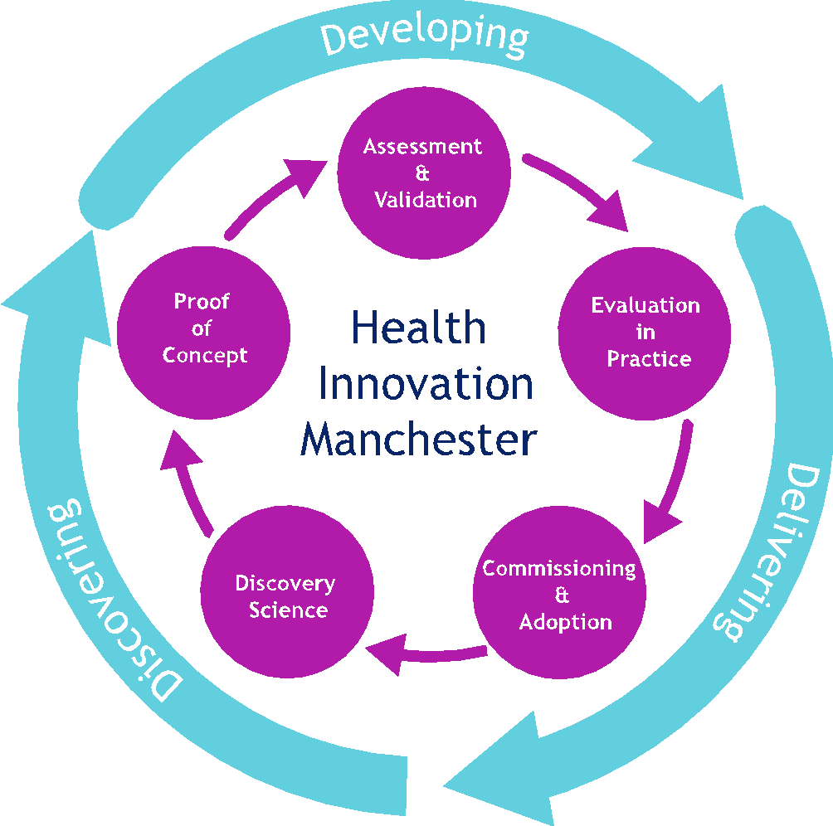







GM’s Academic health science science innovation system
An academic health science and innovation system, empowered by devolution to seek out and drive proven innovation into health and social care services at pace.
Industry Partnerships
Industry
partnerships
Commissioners
and providers
Academia and research
National agencies
and government

Slide 7

Health Innovation Manchester
An organisation and a system powered by extreme collaboration that represents a new way of working.
HInM: an organisation
Health Innovation Manchester was formed in October 2017 by bringing together the former academic health science network and academic health science centre under one single umbrella, which also represents Greater Manchester’s wider research and innovation system.
HInM: a system
Although we are an organisation which directly employs people, we also represent research and innovation agencies working across the entirety of Greater Manchester. The success of Health Innovation Manchester is intertwined with the success of our partners, so we work as one system.
Providers
Commissioners
Academia /
Care delivery
Industry
Councils
Industry engagement /
project management office
HInM: funding model
Multiple commissioners and developing a sustainable funding model delivering value to all stakeholders
GM Health & Social Care Partnership
Academia

Slide 8





Health Innovation Manchester: Our aims
Our vision is to be a recognised international leader in accelerating innovation that transforms citizen’s health and wellbeing.
Ensure a constant innovation pipeline into health and social care.
Prioritise and monitor innovation activities that meet the needs of GM.
Accelerate delivery of innovation into health, care and wellness delivery.
Amplify existing academic and industry value propositions.
Influence national and international
policy.
Notes:
You can quickly draw parallels between our aims in Greater Manchester and those outlined in the IPHA Manifesto for Health!
Bringing Innovative medicines to all patients faster - Accelerate delivery of innovation into health, care and wellness delivery.
Build capacity to discover and make tomorrows cures – Ensure a constant innovation pipeline into health and social care
Working together to advance patients interests – Prioritise and monitor innovation activities that meet the needs of GM

Slide 9
Health Innovation Manchester: how we deliver our aims
Pivoting our operating model for effective delivery.
Prioritisation and monitoring of innovation
Project and programme management
Clinically-led analytics and pathway redesign
Clinical engagement
Digital
innovation
Industry engagement
Academic partnerships
Research and education expertise and engagement
GM system engagement and leadership
Strategic communications
Underpinned by:
Culture
Values
Behaviors
Methods
Digital mindset

Slide 10
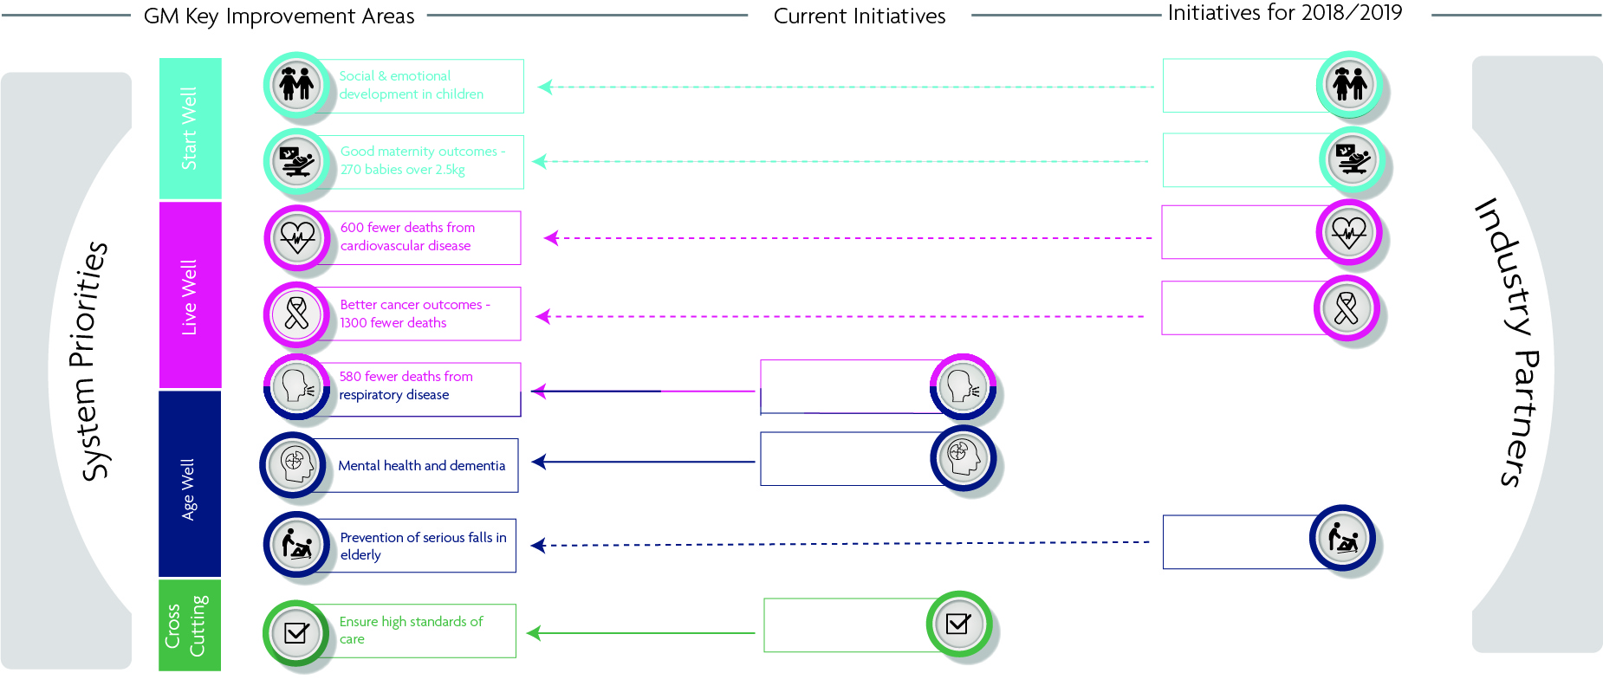
Driving innovation to the needs of Greater Manchester
Health Innovation Manchester: Providing structure, organisation and a systematic approach to qualification, assessment and the prioritisation of innovations within the health and social care system
GM Strategic Plan Priorities
Start Well
9 aims
Innovation programmes aligned to GM priorities
Live Well
34 aims
System-wide Innovation and Prioritisation Monitoring Committee
Heath Innovation Manchester
Age Well
13 aims
Cross-cutting themes
13 aims

Slide 11
Three major opportunities
Opportunities to highlight where system-wide innovation keeps people well, reduces pressure on providers, supports economic growth, and improves health outcomes for citizens and patients.
The future of healthcare and medicine will be:
A new approach to working with industry
New business models
Driven by exciting advances in basic research, particularly in genomics, digital technologies.
The development of health data analytics, using integrated big data sets.
Using exceptional insight into entire citizen-level health pathways, and the ability to evaluate treatments and care pathways.
A streamlined and accelerated decision-making structures to aid industry in navigating disjointed systems.
The Association of British Pharmaceutical Industries (ABPI)and Association of British HealthTech Industries have both signed an MOU with Greater Manchester to bring forward a pipeline of innovations for rapid adoption.
Will enable us to tackle the perverse incentives in existing health and care funding which inhibit investment.
Evaluation of costs and benefits of innovations across the whole care pathway, outside of individual institutional boundaries.
Develop funding models which incentivise providers to invest in innovation.
Notes:
Here speak to how the system is ready for an AHSS – there has always been a history of collaboration in Manchester, devolution just cements it and also allows for more possibility as we now have more control over our finances and how to direct them.
The biggest change that we could make is to stop silo and in-year budgeting between different parts of the health and social care system

Slide 12
System drivers vs industry drivers
Aging population
Pace, cost and risk of innovation
Changing lifestyles - Increased chronic disease
Impact of globalization
Innovation has a vital role to play if we are to continue to improve outcomes for patients and deliver value for money
Unacceptable variation
Changing definitions of value and price
Precision Medicine
Shifting health policy, legislation, reforms and regulations
Shift to more preventative and predictive treatment
Reshaping value propositions across the healthcare ecosystem
Financial and capacity challenges
Rise in consumer accountability and power
Notes:
Pace, cost, and risk of innovation
Increased pressure to bring products and services to the market has led to a push toward “patient-centric” and personalized care models.
Impact of globalization
Competition is global and emerging markets all over the world are disrupting the industry. Meanwhile, adhering to government regulations around taxation, trade, approvals, market access, and pricing continues to be a struggle.
Changing definitions of value and price
Increasing pressure to lower drug prices and non-traditional ways of serving patients, such as education, support, and self-administration, means pricing is more value-based. Gartner recommends that CIOs strengthen their analytics to evaluate data, predict revenue and services, and make comparisons on a national level.
Shifting health policy, legislation, reforms, and regulations
Government policy, funding level, law, and regulation are constantly changing around the globe, and these continue to affect how life sciences organizations operate.
Reshaping value propositions across the healthcare ecosystem
“Coopetition” will become more common between organizations as they develop new business models and create winning business strategies.
Rise in consumer accountability and power
Patients will control most of the power due to the growing impact of omni-channel communication between consumers and organizations.

Slide 13
System assets vs industry assets
Only by leveraging and combining all of the assets of both the health and care system along side those of industry can we tackle the mounting healthcare challenges
Research Excellence
Market Knowledge
Specialist tools & services
System
Providers & Commissioners
Industry
Real World Evidence
(Through GM’s interconnected data capability)
Global insights & best practice
Notes:
To mention – the challenges that we have faced in working collaboratively across commissioners, providers and the pharmaceutical industry and how we have been dealing with them eg.
Working hard to dispel the myth that pharmaceutical companies are driven only by shareholder value / revenue and profit
Communicating the value added that can be derived from the Pharma industry – such as their expertise in health economics, highlighting their investment in the system (financial and human resources)
Formalised agreement in the form of an MoU that focuses on optimising medicines to ensure the system gets value for money from it’s medicines spend, Pharma investment in discovery and development, our investment in building capacity for discovering and developing – digital infrastructure and reporting back to the system against those parameters.
The MoU with pharma is not about selling more medicines into the system

Slide 14





Industry led innovation
HInM works with SMEs and industry leaders to develop innovations to meet GM population needs and promote GM as a global leader for life sciences.
Strategic alliances:
ABPI
ABHI
Cancer Research UK
Dementia Industry Group
Support services :
Innovation Nexus portal – 400 companies supported since 2014
Innovation funding programmes
Adoption/procurement advice
NICE Meta tool to understand evidence required
Regional digital accelerator
ERDF Life Sciences Programme
  53 companies have received intensive support
  46 companies trained via STEP Into Healthcare
  54 companies attended masterclasses

Slide 15
A systematic approach to translation & adoption
Adoption and spread will be delivered through the Joint Commissioning and Provider Federation Boards, with HInM providing stakeholder engagement, project management, economics and evaluation support
PAF submission
PMO Review
IPMC Decision
Screening & triage
Capture of basis information entered into innovation database
Qualification & Validation
  PAF development
  Business Case
Development of PAF into business case
Business case approved - project initiation

Slide 16
Working in partnership to overcome the barriers + learnings
Common themes that consistently continually arise from workshops include; Digital, Real world evidence, New commissioning models and reducing variation
Barriers
Learnings
Healthcare provider capacity and culture
Culture-differences across sectors
Lack of shared understanding and difference of culture between industry and NHS
Infrastructure is fragmented and limits adoption and uptake of evidence
Varying and sometimes conflicting priorities and practices
Identify industry solutions to problems (not individual companies) – explore ways to work together between companies
Develop a shared understanding of language, used consistently by all
Improving understanding between industry and health and social care – dispel myths
Promote a guide to navigating the various decision making meetings, including relevant forms
Notes:
System-wide showcases on key priority areas
Good communication channels between Health Innovation Manchester and industry

Slide 17









GM assets for precision medicine
Genomics and other biomarkers
Scientific and clinical research excellence
Civic leadership and strategy
Collaboration and partnership
Effective commissioners and providers
Citizen engagement and trust
£
£
Digital transformation
Novel business models
Industry partnerships

Slide 18
Our GM transformational methodology
All underpinned by digital
Industry and academic engagement to develop, deliver, and evaluate products and services supported by real world data and evidence
Working with Industry to use digital approaches to move up the value chain
Clinical and data science expertise to develop and deploy advanced approaches to provide enhanced actionable insights from comprehensive data
To drive better clinical and business outcomes
Computer science evolution to transform our ability to tackle healthcare problems at scale and at pace

Slide 19
COPD & Hep C elimination: novel ways of deploying industry expertise
Implementation of GM integrated COPD pathway
Hepatitis C Elimination Programme
Support from GSK/Pfizer/Chiesi:
Secondment of senior project manager from industry
Provision of practice based clinical pharmacy run clinics
Support from Abbvie/MSD/Gilead:
Support for Hep C pathway mapping
Proposed case finding solutions
Provision of point of care testing devices
Notes:
Ben & Erik
COPD - Working with all 6 industry partners in this space to offer support as well evaluation of impact of interventions
Hepatitis C Elimination Programme This project is looking to expand on the ambitions of NHSE to eliminate Hep C by 2025 by providing a potential blueprint to elimination by 2023 - is looking at changing the way patients flow through the system - How we identify them, engage them, treat them.

Slide 20
Atrial Fibrillation (AF) & Psoriasis Rapid Access Clinic (P-RAC)
Atrial Fibrillation (AF)
Psoriasis Rapid Access Clinic
Support from Amgen/Bayer/Pfizer:
Identification & management of AF within a GM CCG, via a specialist Arrhythmia nurse service
Mobile detection devices
AF self-testing education
Support from Celgene:
Clinical Research Fellow (1FTE)
Research Fellow - Secondment of senior person from industry

Slide 21
GM infrastructure for digital
Local relevance and value with regional and national connectivity
Regional and national interoperability
Interoperability Hub
(Local Health Care Record Exemplar)
Single instance of Interoperable Health and social care record for 2.8 M citizens
Digital Innovation Hub
infrastructure for
RWE trials,
data science
Pharma
Med Tech
Technology
Digital transformation
Technology
Academia
Embedded governance at city region level
Direct care
Performance management and payment reform
Service planning and reform
Population health/wellness

Slide 22



How digital and HInM is supporting the ABPI
Using increasingly digital approaches
Work across industry/academia/
industry to develop novel value propositions supported by real world data
Demonstrate proof of value in real world settings using appropriate methodology and data infrastructure
Prioritise GM level innovation delivery activity across the city region and feed into national AHSN network

Slide 23




Questions?

Slide 24
Slide Reservoir

Slide 25
System drivers vs industry drivers
Aging population
Pace, cost and risk of innovation
Changing lifestyles - Increased chronic disease
Impact of globalization
Innovation has a vital role to play if we are to continue to improve outcomes for patients and deliver value for money
Unacceptable variation
Changing definitions of value and price
Precision Medicine
Shifting health policy, legislation, reforms and regulations
Shift to more preventative and predictive treatment
Reshaping value propositions across the healthcare ecosystem
Financial and capacity challenges
Rise in consumer accountability and power
Notes:
Pace, cost, and risk of innovation
Increased pressure to bring products and services to the market has led to a push toward “patient-centric” and personalized care models.
Impact of globalization
Competition is global and emerging markets all over the world are disrupting the industry. Meanwhile, adhering to government regulations around taxation, trade, approvals, market access, and pricing continues to be a struggle.
Changing definitions of value and price
Increasing pressure to lower drug prices and non-traditional ways of serving patients, such as education, support, and self-administration, means pricing is more value-based. Gartner recommends that CIOs strengthen their analytics to evaluate data, predict revenue and services, and make comparisons on a national level.
Shifting health policy, legislation, reforms, and regulations
Government policy, funding level, law, and regulation are constantly changing around the globe, and these continue to affect how life sciences organizations operate.
Reshaping value propositions across the healthcare ecosystem
“Coopetition” will become more common between organizations as they develop new business models and create winning business strategies.
Rise in consumer accountability and power
Patients will control most of the power due to the growing impact of omni-channel communication between consumers and organizations.

Slide 26
The digital transformation opportunity
Digital transformation brings together people, process, culture, tools and technology using; Industry Engagement, Data Science Expertise and Computer Science Techniques
Industry engagement to deliver digital products and services based on Real World Evidence to the Life Science and Biotech industries
Data science expertise to deploy advanced technologies to provide enhanced insights from comprehensive data
It will drive better clinical and business outcomes by:
Computer science techniques to transform our ability to tackle healthcare problems at scale and at pace across Greater Manchester

Slide 27
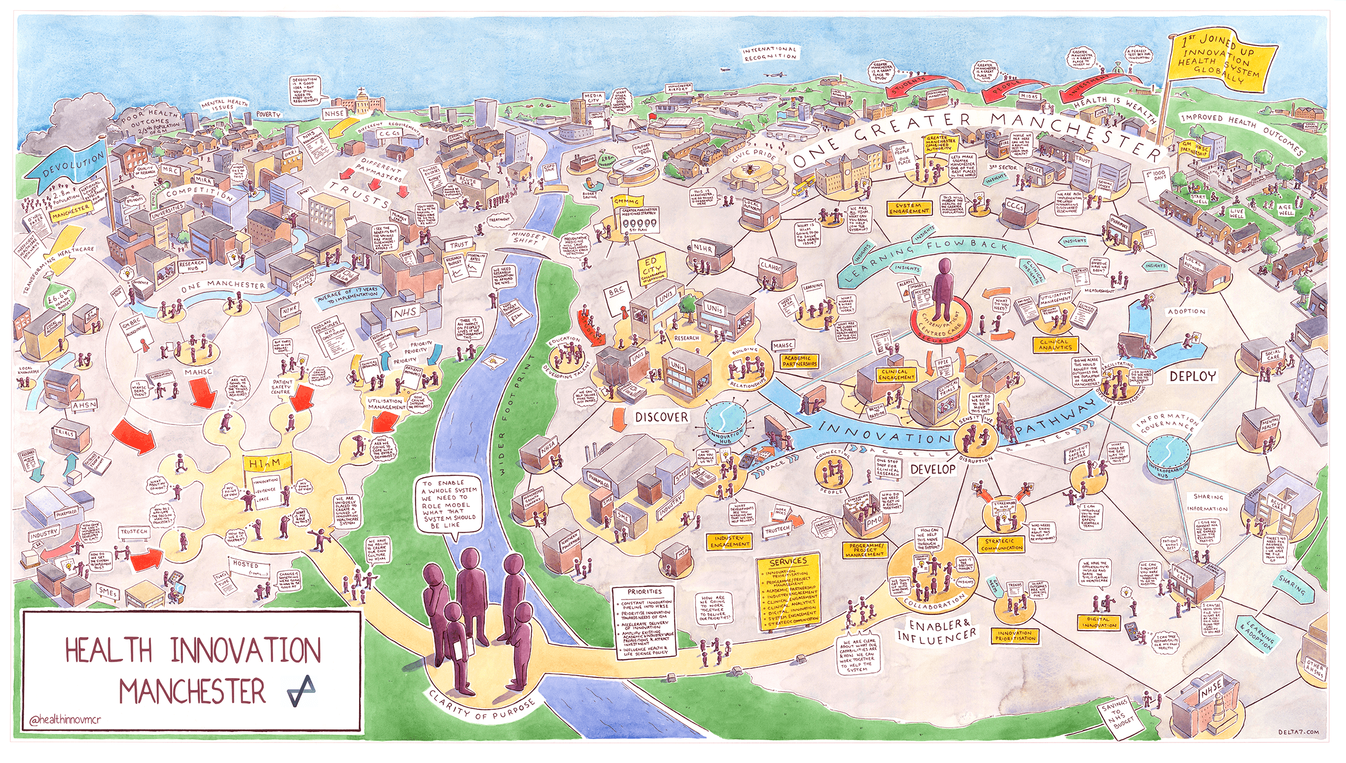

Slide 28
Greater Manchester’s Priorities
Devolution has created a unique and exciting opportunity to take a system-wide view of the region’s most pressing health needs; agreeing shared priorities, streamlining processes to enable faster decision-making, and eliminating perverse financial incentives that have inhibited investment in innovation.
Objectives
Outcomes
Transform the health and social care system to help more people stay well and take better care of those who are ill.
More GM children will reach a good level of development cognitively, socially and emotionally.
More people will be supported to stay well and live at home for as long as possible.
Align our health and social care system to wider public services such as education, skills, work and housing.
More GM families will be economically active and family incomes will increase.
Fewer will die early from cardio-vascular disease (CVD), cancer and respiratory disease.
Create a financially balanced
and sustainable system.
Fewer GM babies will have a low birth weight resulting in better outcomes for the baby and less cost to the health system
Make sure our services are clinically safe throughout.

Slide 29




Devolution is a catalyst for change
The challenges in GM
!
Medicinal & Technological advancement challenges
Information and Service Integration
Effective Payment Model Discovery & Implementation
Increase in population Health Management
Rising costs of Healthcare
Medical and technology innovations have together produced radical service delivery advancements. Despite monumental improvements, society is only experiencing the beginning phase of this process
The challenge in the health & care system including innovation
Notes:
Ben
Information and Service Integration
The medical community easily welcomes big data advancement, but implementation is not as fluid. Non-relational databases merge patient information from many sources, providing actionable metrics. The technology presents itself at the perfect time to fill the need to exploit newly available patient information stores. However, because of limited access to patient information, drug manufacturers waste immeasurable expenses on research and development, which is passed on to consumers. Educating patients on how information sharing reduces costs is essential to developing a free information flow facilitating medical advancements and helping care providers develop more personalized service delivery plans. Patients understanding these benefits are more willing to share medical records with third parties.
Effective Payment Model Discovery and Implementation
Under the new models, financial incentives hinge on patient outcomes rather than service quantities. The new models include incentives, such as:
Bundled payments
Disbursements to patient-oriented care providers
Global payments
Shared savings
However, It can be difficult to secure provider participation in the models and monitoring processes. Further complicating the matter is that the new payment models are adjustments, rather than complete overhauls, and measuring return-on-investment proves difficult
Rising costs of Healthcare
As more people strive to live longer, healthier and more active lifestyles, healthcare concerns increase and so does the costs. Research reveal healthcare costs and spending often rise at rates exceeding inflation, and is expected to increase in the future
Medicinal & Technological advancement challenges
The proliferation of new technology in healthcare is exploding as such, the pressure and “growing influx of patient data, legal requirements for strict privacy and security, regulatory requirements, or sometimes lack of clear regulatory requirements not only increases costs but also can overwhelm the health system
Interest in population health management will grow.
Even though many people in the healthcare industry are talking about population health management there isn’t a common definition for what it means yet. But Population health management is a proactive application of strategies and interventions to defined cohorts of individuals across the continuum of healthcare delivery in an effort to maintain and/or improve the health of the individuals within the cohort at the lowest necessary cost.
As the risk for a population of patients shifts to the provider, health systems need to know more about the patients they serve, success will depend of the combination of three systems:: technology (data), deployment (execution strategy), and content (clinical knowledge)

